Slide 1

L9.2: Message Authentication Code 第9.2讲：消息认证码
（深圳）
Lecturer: Zoe L. JIANG
A309
Oct 11, 2018, 15:45-17:30
Most of the slides come from http://drona.csa.iisc.ernet.in/~arpita/Cryptography17.html

Slide 2
Towards Achieving CCA-Security
What capability of adv lets him win?
>> Easy to manipulate known ciphertexts to obtain new ciphertexts so that the relation between the underlying messages are known to him. then he gets DO service on the changed ciphertext to get the message.. Using the relation retrieve the original message
>> This is called malleability. CPA-secure scheme does not guarantee non-malleability
Need a SKE so that
>> Creating a new ciphertext will be nearly impossible…
>> Changing a ciphertext should either result in an incorrect ciphertext or should decrypt to a plaintext which is unrelated to the original plaintext
>> Together, the above two makes DO useless to the adversary.
Message Authentication Codes (MAC) helps us to get such a SKE!!
Notes:
But building CCA-secure scheme is just one application of MAC. The prime cause of MAC being a celebrated primitive is because it offers message integrity and authentication– two fundamental needs of cryptography.

Slide 3
Today’s Goal
Message Authentication Code (MAC)
Definitions- cma, scma, cmva, scmva
Construction from PRF
Domain Extension: How to find a tag for long message
CBC-MAC
Authenticated Encryption (AE)- message privacy + integrity
Definition
Any AE is cca-secure. Stronger than cca-security. Nontrivial proof
Construction of AE from- cpa-secure SKE + cma-secure MAC

Slide 4
Message Integrity and Authentication
In secure-communication, is it enough to keep privacy of the message?
What is the guarantee that a message received by R indeed originated from S and vice-versa ?
--- issue of message authentication
Even if it is confirmed that the message received by R originated from S, what is the guarantee that the message content is genuine ?
--- issue of message integrity
Message integrity and authentication are also part of secure communication
Message authentication/integrity is important even when privacy is not a concern
Any kind of access control system needs them. Think of bank, institute, any organization
Encryption scheme does not help (unless designed with specific purpose of MI and MA).
Consider all the CPA secure schemes considered so far (PRF-based, modes of operations); none provide MI/MA
Spoofing attack is easy. Changing ciphertext and thereby changing the underlying message is easy!!

Slide 5
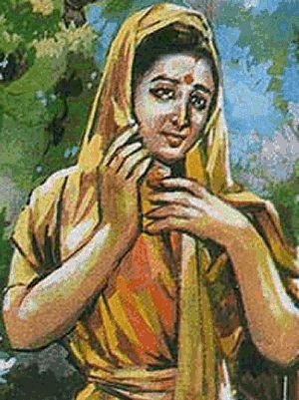


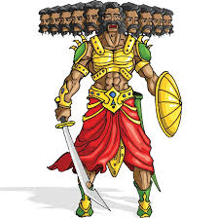
Message Authentication in Private Key Setting
m
m
m,t
0/1
Tag Generation
Verification
k
k
Secret key k shared in advance (by “some” mechanism)
m is the plain-text
t is the tag
Symmetry: same key used for tag generation and verification

Slide 6
Syntax of Message Authentication Codes (MAC)
A MAC is a 3-tuple (Gen, Mac, Vrfy) of algorithms with the following syntax
Key-generation Algorithm (Gen(1^{n})):
1^{n}
k
Input: 1^{n}
Gen
Output: key k (usually uniform at random from {0, 1}^{n}
Running time: O(Poly(n)); MUST be randomized
2. Tag Generation Algorithm (Mac_{k}(m)); m from {0,1}*:
k
Input: m,k
m ∈{0, 1}*
Tag t
Output: Tag t
Mac
Running time: O(Poly(n)); Deterministic/Randomized
3. Verification Algorithm (Vrfy_{k}(m,t)):
k
Input: (m,t),k
m ∈{0, 1}*, t
0/1
Output: 0/1
Vrfy
(Invalid/Valid)
Running time: O(Poly(n)); Deterministic (usually)

Slide 7
Syntax of MAC
Any MAC defines the following three space (sets):
Key space (K):
Set of all possible keys output by algorithm Gen
2. Plain-text (message) space (M):
Set of all possible “legal” message (i.e. those supported by Mac)
3. Tag space (T):
Set of all tags output by algorithm Mac
The sets M and K together define the set T
Any MAC is defined by specifying (Gen, Mac, Vrfy) and M
Correctness: For every n, every k output by Gen and every message m the following should hold :
Vrfy_{k}(m, Mac_{k}(m)) = 1
Notes:
M is independent of the scheme so it should be a part of the description. Other sets are subsumed in the triple algorithms description.

Slide 8

Security for MAC
Randomized
PPT
Chosen Message Attack (CMA)
It is not possible to come up with (m,t) if no tag on m is not seen before
It is not possible to come up with (m,t) if (m,t) is not seen before
Randomized
PPT
Chosen Message and Verification Attack (CMVA)
It is not possible to come up with (m,t) if (m,t) has not been seen before.
It is not possible to come up with (m,t) if (m,t) is not seen before

Slide 9

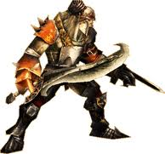
MAC Experiment
Experiment Mac-forge (n)
Π = (Gen, Mac, Vrfy), n
A, Π
Attacker A
Plz give me the tag for m₂
Plz give me the tag for m_{l}
Plz give me the tag for m₁
t₂ ← Mac_{k}(m₂)
t_{l} ← Mac_{k}(m_{l})
t₁ ← Mac_{k}(m₁)
k
I can break Π
Let me verify
Gen(1^{n})
Run time: Poly(n)
Training phase :
A gets tag for several messages of its choice adaptively --- access to Mac-oracle

Slide 10
MAC Experiment
Experiment Mac-forge (n)
Π = (Gen, Mac, Vrfy), n
A, Π
Attacker A
Training Phase
(m, t)
k
I can break Π
Let me verify
Forged tag generated by A
Gen(1^{n})
Run time: Poly(n)
Q = {(m₁, …,m_{l} } denotes the set of all queries that A asked its oracle
game output
1 (A succeeds) if Vrfy_{k}(m, t) = 1 and m ∉ Q
0 (A fails) otherwise
Definition 4.2 Π is existentially unforgeable under an adaptive chosen message attack or cma- secure if
Pr [Mac-forge (n) = 1] ≤ negl(n)
A, Π

Slide 11
MAC Experiment
Experiment Mac-sforge (n)
Π = (Gen, Mac, Vrfy), n
A, Π
Attacker A
Training Phase
(m, t)
k
I can break Π
Let me verify
Forged tag generated by A
Gen(1^{n})
Run time: Poly(n)
Q = {(m₁, t₁), …,(m_{l} , t_{l})} denotes the set of all queries that A asked its oracle
game output
1 (A succeeds) if Vrfy_{k}(m, t) = 1 and (m, t) ∉ Q
0 (A fails) otherwise
Definition 4.3 Π is existentially unforgeable under an adaptive chosen message attack or strong cma-secure if
Pr [Mac-sforge (n) = 1] ≤ negl(n)
A, Π

Slide 12
What is not Captured in MAC Security Definition
If A returns (m,t) for a already queried message, we don’t consider that as the break.
>> What it captures in real scenario? if (m,t) is a valid pair generated by the sender, then there is no harm if the receiver accepts it even though adv forwards it (may be at a later point of time)
>> Is it problematic?
>> Let a bank user X sends the following instruction to the bank:
“transfer $1000 from account #X to account #Y“
>> What if an attacker simply sends 10 copies of the original (message, tag) pair --Bank will consider each request genuine --- disaster for X
>> The above attack is called replay attack
Why Replay Attack is not taken care in MAC Definition
>> Whether this attack is of concern depends on actual application scenario
>> So it is better to deal with this in the outer protocol (that used MAC for authentication)
>> Additional techniques like (synchronized) counters, timestamp, etc are used

Slide 13
Fixed-length MAC from PRF
Let F:{0, 1}^{n} x {0, 1}^{n} → {0, 1}^{n} be a PRF
Then Π = (Gen, Mac, Vrfy) is a fixed-length MAC for n-bit strings where :
Construction 4.5
k
k
1^{n}
k∈_{R} {0, 1}^{n}
m∈{0, 1}^{n}
t:= F_{k}(m)
m,t
0, if t ≠ F_{k}(m)
Gen
Mac
Vrfy
1, if t = F_{k}(m)
(Deterministic Mac)
Theorem 4.6: If F is a PRF then Π is a cma-secure MAC.
Show that if Π is not cma-secure then F is not a PRF by designing a distinguisher for F
If instead a TRF f was used to compute tag then an attacker can guess f(m) for a “new” m with probability at most 2^{-n}
The same should hold even if a PRF is used (as key is unknown)

Slide 14


Security Proof
Theorem 4.6. If F_{k} is a PRF, then Π is a CMA-secure scheme.
Proof: Assume Π is NOT secure
cma
cma
A, p(n):
Pr
forge (n)
= 1
>
Pr
1/p(n)
forge (n)
= 1
= 2^{-n}
A, Π
A, Π
=
F_{k}
=
f
Pr [D () = 1]
Pr [D () = 1]
D
A
m₁
m₁
y₁
(m₁, y₁)
F_{k}(PRF)
f (TRF)
Repeat
Repeat
Q = {m₁, …,m_{l} }
m
(m,t)
y
1 if y = t & m ∉ Q
0 otherwise

Slide 15
Domain Extension
Given a scheme that handles fixed-length message.
How to handle arbitrary-length messages
SKE
MAC
Break the message into blocks and encrypt each block using fixed-length scheme (minimum security notion CPA-security)
The same does not work here– Additional tricks necessary
Want efficiency?– Go for Mode of operations
Want efficiency?– CBC-MAC, C-MAC, Hash-and-MAC, HMAC

Slide 16


Domain Extension
Warning!! Simple ideas do not work !!
Attempt I
Divide the message into blocks and authenticate each separately via fixed-length MAC
n
n
n
m
m₁
m₂
m₃
k
Mac
Mac
Mac
Mac_{k}(m) = t = t₁ || t₂ || t₃
t₁ = Mac_{k}(m₁)
t₂ = Mac_{k}(m₂)
t₃ = Mac_{k}(m₃)
Block re-ordering attack :
Given (m, t), where m = m₁ || m₂ || m₃ and t = t₁ || t₂ || t₃
Then (m’, t’) is a valid pair, where m’ = m₂ || m₁ || m₃ and t’ = t₂ || t₁ || t₃
Notes:
CPA secure Encryption scheme it was easy…just encrypt for individual blocks..similar idea does not work..this shows that MAC is a completely different ball game.

Slide 17
Domain Extension for MAC
Warning!! Simple ideas do not work !!
Attempt II
Prevent the previous attack by authenticating block index along with each block
n
n
n
m
1
m₁
2
m₂
3
m₃
k
Mac
Mac
Mac
Mac_{k}(m) = t = t₁ || t₂ || t₃
t₁ = Mac_{k}(1 || m₁)
t₂ = Mac_{k}(2 || m₂)
t₃ = Mac_{k}(3 || m₃)
Truncation attack :
A valid (msg, tag) pair can be generated by dropping (msg, tag) blocks from the end
(m₁ || m₂, t₁ || t₂) is a valid new (msg, tag) pair generated from (m₁ || m₂ || m₃, t₁ || t₂ || t₃)

Slide 18
Domain Extension for MAC
Warning!! Simple ideas do not work !!
Attempt III
Prevent the previous attack by additionally authenticating message length with each block
l = 3n
m
l
1
m₁
l
2
m₂
l
3
m₃
k
Mac
Mac
Mac
Mac_{k}(m) = t = t₁ || t₂ || t₃
t₁ = Mac_{k}(l || 1 || m₁)
t₂ = Mac_{k}(l || 2 || m₂)
t₃ = Mac_{k}(l || 3 || m₃)
Mix-and-match attack :
Suppose attacker learns (m₁ || m₂ || m₃, t₁ || t₂ || t₃) and (m’₁ || m’₂ || m’₃, t’₁ || t’₂ || t’₃) where | (m₁ || m₂ || m₃) | = | (m’₁ || m’₂ || m’₃) |
Then (m₁ || m’₂ || m₃, t₁ || t’₂ || t₃) is a valid, new (message, tag) pair

Slide 19
Domain Extension for MAC
Warning!! Simple ideas do not work !!
Ahhhh Finally!
Attempt IV
Prevent the previous attack by additionally authenticating a random identifier with each block; a fresh random identifier for each message
Construction 4.7
l
m
r
l
1
m₁
r
l
2
m₂
r
l
3
m₃
k
Mac
Mac
Mac
Mac_{k}(m) = t = t₁ || t₂ || t₃
t₁ = Mac_{k}(r || l || 1 || m₁)
t₂ = Mac_{k}(r || l || 2 || m₂)
t₃ = Mac_{k}(r || l || 3 || m₃)
Is this construction secure ? --- yes (it is in fact a randomized MAC)
Is Randomization necessary for domain extension?-- NO
But this is highly inefficient --- each invocation of Mac is now invoked only on n/4 bits of m
So if |m| = dn bits, then it requires 4d invocations of Mac algorithm and tag size is 4dn bits
Notes:
There are lots of applications out there for authentication where resource constrained devices are involved. RFID chips in identity cards. Randomization is a bane for such devices..need to go for determinism..

Slide 20
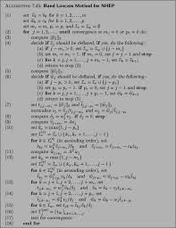
CBC-MAC for Arbitrary-length Messages
Let F: {0, 1}n x {0, 1}n → {0, 1}n be a PRF, whose key k is agreed between S and R
Let S has a message m with |m| = dn, where d is some polynomial in n
CBC-Mac:
m
m₁
m₂
m₃
|m|
⊕
⊕
⊕
k
F
F
F
F
t = Mac_{k}(m)
Length of m (i.e. |m|) need to be prepended, not appended --- otherwise insecure
4dn bits
4d invocations of PRF
The tag consists of only n bits
Highly efficient
Only d invocations of PRF

Slide 21

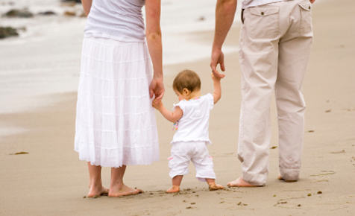
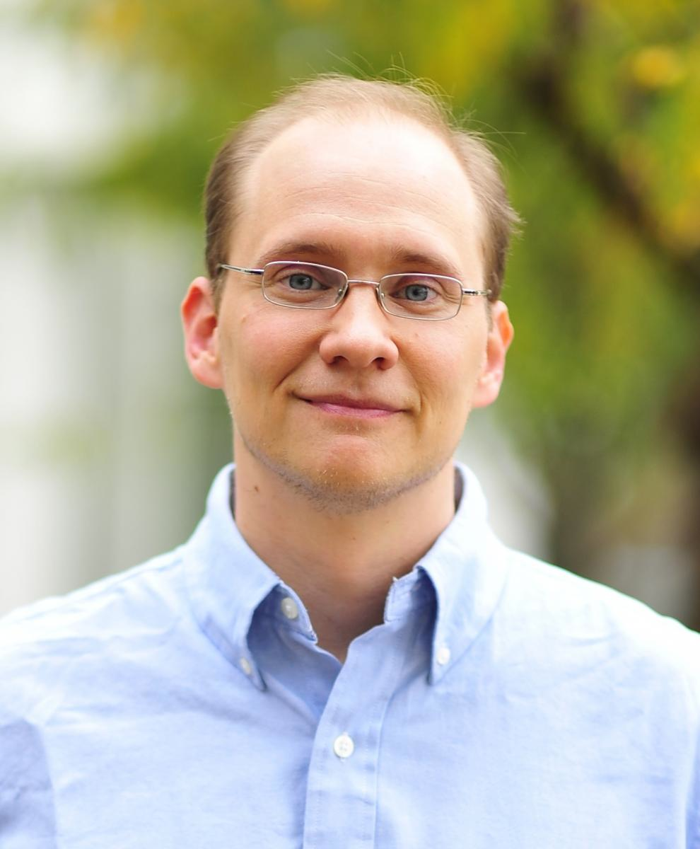

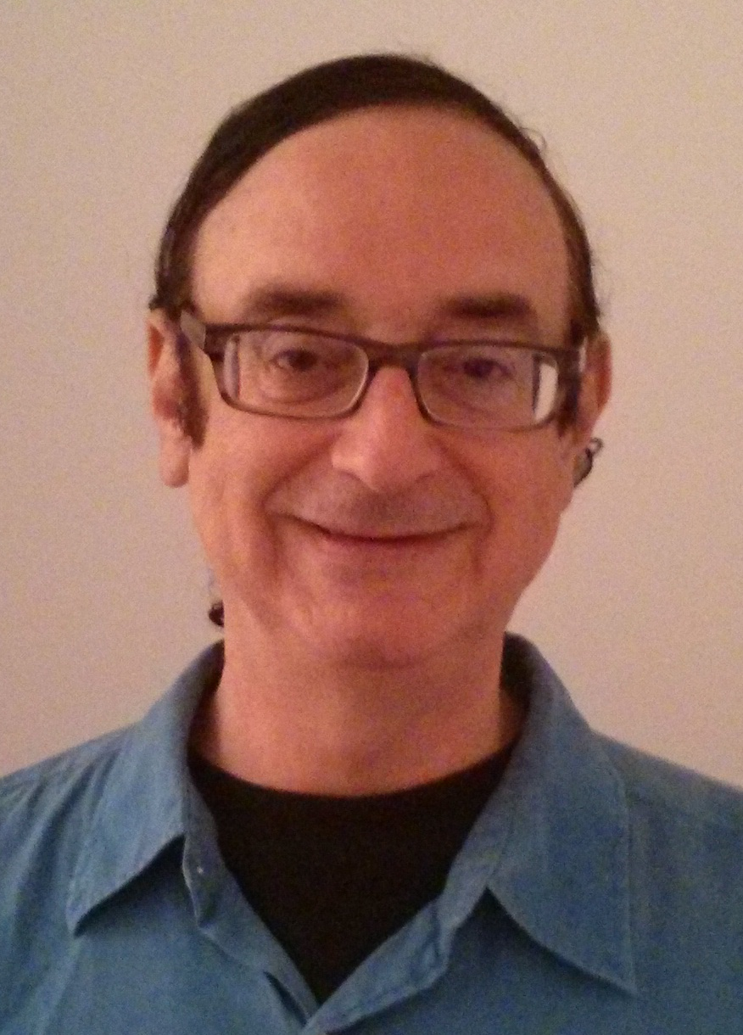
The Picture Till Now
SKE
MAC
Privacy
Integrity & Authentication
Not necessarily provide integrity and authentication;
>> easy to come of with a valid ciphertext
>> easy to manipulate known ciphertext
Not necessarily provide privacy;
>> Easy to distinguish tags of two different messages
Authenticated Encryption
Mihir Bellare, Chanathip Namprempre:
Authenticated Encryption: Relations among Notions and Analysis of the Generic Composition Paradigm. ASIACRYPT 2000: 531-545
Jonathan Katz, Moti Yung:
Unforgeable Encryption and Chosen Ciphertext Secure Modes of Operation. FSE 2000: 284-299
Notes:
They complement each other so nicely. What do you think about them as a couple. Let’s marry them off. Think of their child. Wonderful features. Privacy and authetication together! But w are not the ones to note it first and foresee the qualities of their child.

Slide 22
References
[1] Jonathan Katz, Yehuda Lindell. Chapter 4.1-4.4, Introduction to Modern Cryptography, 2nd Edition, Chapman & Hall/CRC Cryptography and Network Security Series, 2014
[2] http://drona.csa.iisc.ernet.in/~arpita/Cryptography17.html

Slide 23
CMA and strong CMA Security
- It is NOT true that you need randomized MAC to satisfy scma-security
- Any MAC that has canonical verification and cma-secure is also scma-secure.
- Every deterministic MAC has canonical verification
- For deterministic MAC, enough to prove cma-security as scma security is ‘free’
- PRF-based scheme is scma-secure (because it is deterministic and provably cma-secure).

